Slide 1
Project Name :Horse Race Prediction
Name- Abhilash G
Master in Data Science- Guvi
Email – abhilashgnagar22@gmail.com

Slide 2
Problem Understanding
This project aims to predict horse racing outcomes using machine learning techniques.
The dataset spans from 1990 to 2020 and includes detailed information on races and individual horses.
Given the inherent complexity and unpredictability of horse racing, the project explores various machine learning models.
Feature engineering techniques are employed to enhance prediction accuracy.
The dataset comprises two main types of files: races and horses.
Data for each year from 1990 to 2020 is available.
Additionally, there is a file named forward.csv that contains pre-race information.

Slide 3
Solution
Evaluate various machine learning models including Regression, Random Forest, Gradient Boosting, and Neural Networks.
Utilize cross-validation techniques to assess the performance of each model.
Apply techniques such as SMOTE (Synthetic Minority Over-sampling Technique), under-sampling, and adjustments of class weights to address imbalanced data issues.
Implement Recursive Feature Elimination (RFE) to select the most relevant features.
Employ regularization techniques to reduce model complexity and mitigate overfitting.
Perform grid search and random search to find the optimal hyperparameters for enhancing model performance.

Slide 4
Goal of the project
Primary Goal: Predict the outcomes of horse races, focusing on win or place results.
Secondary Goals: Identify significant race outcome features, address dataset imbalance, and build a robust prediction model.
Data Preprocessing: Clean data by handling missing values, normalizing where applicable, and converting categorical variables to numerical formats. Engineer features by creating new metrics and aggregating across races, integrating datasets as needed.
Exploratory Data Analysis (EDA): Conduct descriptive statistics and correlation analyses, visualize data distributions and feature relationships using plots and heatmaps.
Model Development: Evaluate various machine learning models through cross-validation, employ techniques like SMOTE for imbalanced data, apply feature selection methods such as RFE and regularization, and optimize hyperparameters using grid and random search.

Slide 5
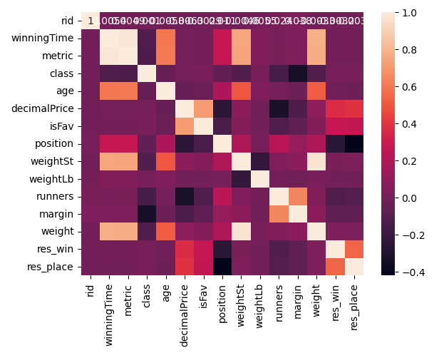
EDA

